Slide 1
Discrete Mathematics
Basic Graph Terminology
Part -1

Slide 2
Basic Graph Terminology
Definition 1:
Two vertices 𝑢 and 𝑣 in an undirected graph G are called adjacent (or neighbors) in G if u and v are endpoints of an edge 𝑒 of G. Such an edge 𝑒 is called incident with the vertices 𝑢 and 𝑣 and 𝑒 is said to connect 𝑢 and 𝑣.
edge (𝑢, 𝑣)
𝑢
𝑣

Slide 3
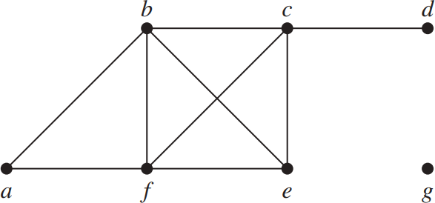
Basic Graph Terminology
Definition 2:
The set of all neighbors of a vertex 𝑣 of 𝐺 = (𝑉, 𝐸), denoted by 𝑁(𝑣), is called the neighborhood of 𝑣. If 𝐴 is a subset of
𝑉, we denote by 𝑁(𝐴) the set of all vertices in 𝐺 that are adjacent to at least one vertex in 𝐴. So, 𝑁(𝐴) = ∪_{𝑣∈𝐴} 𝑁 𝑣 .
𝑵 𝒂
𝑵 𝒃
𝑵 𝒄
𝑵 𝒅
𝑵 𝒆
𝑵 𝒇
𝑵 𝐠 = ∅
= 𝒃, 𝒇
= 𝒂, 𝒄, 𝒆, 𝒇
= 𝒃, 𝒅, 𝒆, 𝒇
= 𝒄
= 𝒃, 𝒄, 𝒇
= 𝒂, 𝒃, 𝒄, 𝒆

Slide 4
Basic Graph Terminology
Definition 3:
The degree of a vertex in an undirected graph is the number of edges incident with it, except that a loop at a vertex contributes twice to the degree of that vertex. The degree of
the vertex v is denoted by deg(v).
deg(𝑎) = 2
deg(𝑏) = 4
deg(𝑐) = 4
deg(𝑑) = 1
deg(𝑒) = 3
deg(𝑓) = 4
deg(g) = 0

Slide 5
Basic Graph Terminology
Isolated:
A vertex of degree zero is called isolated. It follows that an isolated vertex is not adjacent to any vertex.
Vertex g is isolated.
deg(𝑎) = 2
deg(𝑏) = 4
deg(𝑐) = 4
deg(𝑑) = 1
deg(𝑒) = 3
deg(𝑓) = 4
deg(g) = 0

Slide 6
Basic Graph Terminology
Pendant:
A vertex is pendant if and only if it has degree one.
Vertex 𝑑 is pendant.
deg(𝑎) = 2
deg(𝑏) = 4
deg(𝑐) = 4
deg(𝑑) = 1
deg(𝑒) = 3
deg(𝑓) = 4
deg(g) = 0

Slide 7
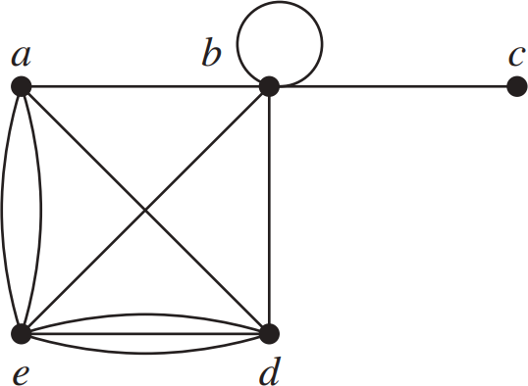
Basic Graph Terminology
Example 1:
What are the degrees and what are the neighborhoods of the vertices in the following graph?
deg(𝑎) = deg(𝑏) = deg(𝑐) = deg(𝑑) = deg(𝑒) =

Slide 8
Basic Graph Terminology
Example 1:
What are the degrees and what are the neighborhoods of the vertices in the following graph?
deg(𝑎) = 4
deg(𝑏) = 6
deg(𝑐) = 1
deg(𝑑) = 5
deg(𝑒) = 6

Slide 9
Basic Graph Terminology
Example 1:
What are the degrees and what are the neighborhoods of the vertices in the following graph?
deg(𝑎) = 4
deg(𝑏) = 6
deg(𝑐) = 1
deg(𝑑) = 5
deg(𝑒) = 6
Vertex 𝒄
is pendant

Slide 10
Basic Graph Terminology
Example 1:
What are the degrees and what are the neighborhoods of the vertices in the following graph?
𝑁(𝑎) =
𝑁(𝑏) =
𝑁(𝑐) =
𝑁(𝑑) =
𝑁(𝑒) =

Slide 11
Basic Graph Terminology
Example 1:
What are the degrees and what are the neighborhoods of the vertices in the following graph?
𝑁(𝑎) = {𝑏, 𝑑, 𝑒}
𝑁(𝑏) = {𝑎, 𝑏, 𝑐, 𝑑, 𝑒}
𝑁(𝑐) = 𝑏
𝑁(𝑑) = {𝑎, 𝑏, 𝑒}
𝑁(𝑒) = 𝑎, 𝑏, 𝑑

Slide 12
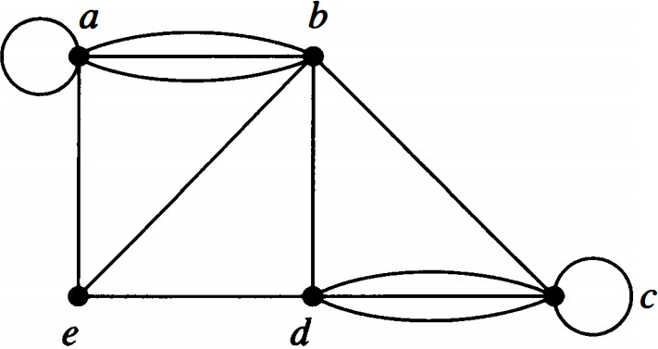
Basic Graph Terminology
Example 2:
What are the degrees and what are the neighborhoods of the vertices in the following graph?
Number of vertices = 5 Number of edges = 13

Slide 13
Basic Graph Terminology
Example 2:
What are the degrees and what are the neighborhoods of the vertices in the following graph?
deg(𝑎) = deg(𝑏) = deg(𝑐) = deg(𝑑) = deg(𝑒) =

Slide 14
Basic Graph Terminology
Example 2:
What are the degrees and what are the neighborhoods of the vertices in the following graph?
deg(𝑎) = 6
deg(𝑏) = 6
deg(𝑐) = 6
deg(𝑑) = 5
deg(𝑒) = 3

Slide 15
Basic Graph Terminology
Example 2:
What are the degrees and what are the neighborhoods of the vertices in the following graph?
𝑁(𝑎) =
𝑁(𝑏) =
𝑁(𝑐) =
𝑁(𝑑) =
𝑁(𝑒) =

Slide 16
Basic Graph Terminology
Example 2:
What are the degrees and what are the neighborhoods of the vertices in the following graph?
𝑁(𝑎) = {𝑎, 𝑏, 𝑒}
𝑁(𝑏) = {𝑎, 𝑒, 𝑑, 𝑐}
𝑁(𝑐) = 𝑏, 𝑐, 𝑑
𝑁(𝑑) = {𝑒, 𝑏, 𝑐}
𝑁(𝑒) = 𝑎, 𝑏, 𝑑

Slide 17
Basic Graph Terminology
The Handshaking Theorem:
Let 𝐺 = (𝑉, 𝐸) be undirected graph with E edges. Then
2|E| = Σ deg(𝑣)
𝑣∈𝑉
edge
Edge having two endpoints and a handshake involving two hands.

Slide 18
Basic Graph Terminology
Example 3:
How many edges are there in an undirected graph with 10 vertices each of degree six?

Slide 19
Basic Graph Terminology
Example 3: Answer
How many edges are there in a graph with 10 vertices each of degree six?
2|E| = Σ deg(𝑣)
𝑣∈𝑉
Solution:
Because the sum of the degrees of the vertices is 6 · 10 = 60, it follows that 2E = 60. Therefore, E = 30.

Slide 20
Basic Graph Terminology
Definition 4:
When (u, v) is an edge of the graph G with directed edges, u is said to be adjacent to v and v is said to be adjacent from u. The vertex u is called the initial vertex of (u, v), and v is called the terminal or end vertex of (u, v). The initial vertex and terminal vertex of a loop are the same.
edge (u, v)
𝑢
𝑣

Slide 21
Basic Graph Terminology
Definition 5:
In a graph with directed edges the in-degree of a vertex 𝑣, denoted by deg⁻(𝑣), is the number of edges with 𝑣 as their terminal vertex.
The out-degree of 𝑣, denoted by deg⁺(𝑣), is the number of edges with 𝑣 as their initial vertex.
(Note that a loop at a vertex contributes 1 to both the in- degree and the out-degree of this vertex.)

Slide 22
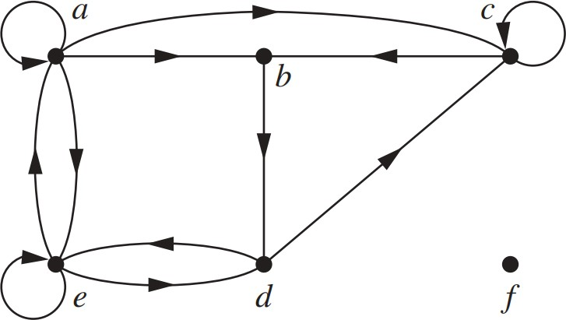
Basic Graph Terminology
Example 4:
Number of vertices =
Number of edges =
deg⁻(𝑎) = deg⁻(𝑏) = deg⁻(𝑐) = deg⁻(𝑑) = deg⁻(𝑒) = deg⁻(𝑓) =
deg⁺(𝑎) = deg⁺(𝑏) = deg⁺(𝑐) = deg⁺(𝑑) = deg⁺(𝑒) = deg⁺(𝑓) =

Slide 23
Basic Graph Terminology
Example 4:
Number of vertices = 6
Number of edges = 12
deg⁻(𝑎) = 2 deg⁻(𝑏) = 2 deg⁻(𝑐) = 3 deg⁻(𝑑) = 2 deg⁻(𝑒) = 3 deg⁻(𝑓) = 0
deg⁺(𝑎) = 4 deg⁺(𝑏) = 1 deg⁺(𝑐) = 2 deg⁺(𝑑) = 2 deg⁺(𝑒) = 3 deg⁺(𝑓) = 0

Slide 24
Basic Graph Terminology
Theorem 3:

Slide 25
Basic Graph Terminology
Example 4: Recall:
Number of vertices = 6
Number of edges = 12
deg⁻(𝑎) = 2 deg⁻(𝑏) = 2 deg⁻(𝑐) = 3 deg⁻(𝑑) = 2 deg⁻(𝑒) = 3 deg⁻(𝑓) = 0
deg⁺(𝑎) = deg⁺(𝑏) = deg⁺(𝑐) =
4
1
2
2
3
0
deg⁺(𝑑) =
deg⁺(𝑒) =
deg⁺(𝑓) =

